Slide 1
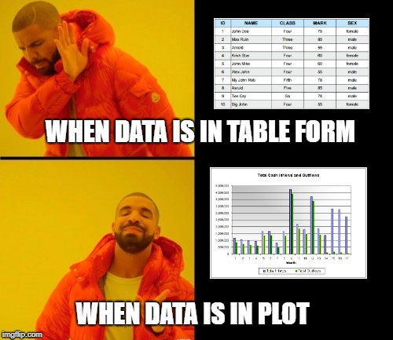
Data Visualization
Figures, axes, subplots, get & set

Slide 2
Topics
Introduction: GUI and basic calculations
Coding 1: Scripts, style, and variable classes
Coding 2: Control statements and loops
Visualization 1: Basics, subplots, get and set
Coding 3: Functions
Visualization 2: Descriptive plots
Coding 4: Basic input and output
Visualization 3: Distribution and 3D plots
Coding 5: Input and output specials – last lecture before holidays
Machine Learning 1: Introduction and dimension reduction
Machine Learning 2: Clustering
Machine Learning 3: Classification
Coding 6: Efficiency and debugging basics
Coding 7: Advanced functions and debugging

Slide 3
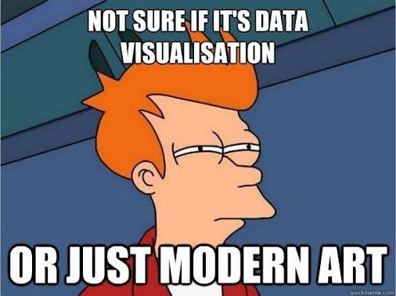
Data Visualization
Vital for data analysis
Can‘t be overstated
Humans are made to process images,
so images we shall make!
Gives an impression of the data,
finding outliers, strange behavior etc.
Plotting data is a form of art, but there are some important factors
Meaningful title
Axes labels (units)
Meaningful scale
Font size!
Distinguishable lines
Legend/Colorscale if necessary

Slide 4
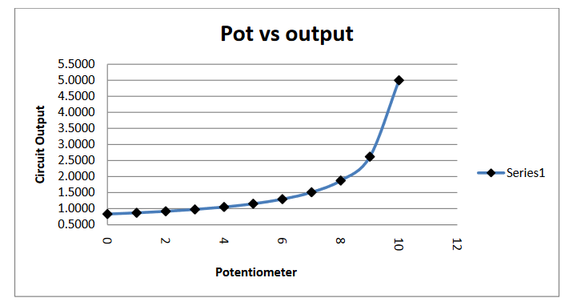
Data Visualization Examples

Slide 5
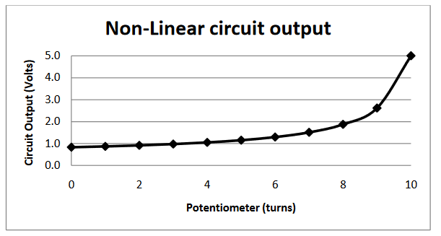
Data Visualization Examples

Slide 6
Plotting
Figure
Relevant optional arguments: (<number>, ‚color‘, ‚white‘)
Clf -> clear figure
Close -> surprise
If you plot, you create axes in the figure and draw
Previous plots are overwritten, except when using „hold on“
Axes can be cleared with „cla“
Multiple axes per figure are posible with subplot

Slide 7
Get & Set
Get & Set are standard ways to access data of objects in many programming languages
MATLAB uses it mainly in the context of plotting
Figures, axes in the figures, and plots in the axes have properties, these can be accessed and changed
gca = get currect axes, gcf = get current figure
When creating a figure, axes or plots, you can also save handles to them
With get and set, you can change all kinds of properties in your figure by code
You can also change these in the GUI, but then it‘s not reproducible

